Slide 1
low_deployment
Pipeline: Low Deployment
Vessel Pathway: Common
Port Pathway: Common

Slide 2
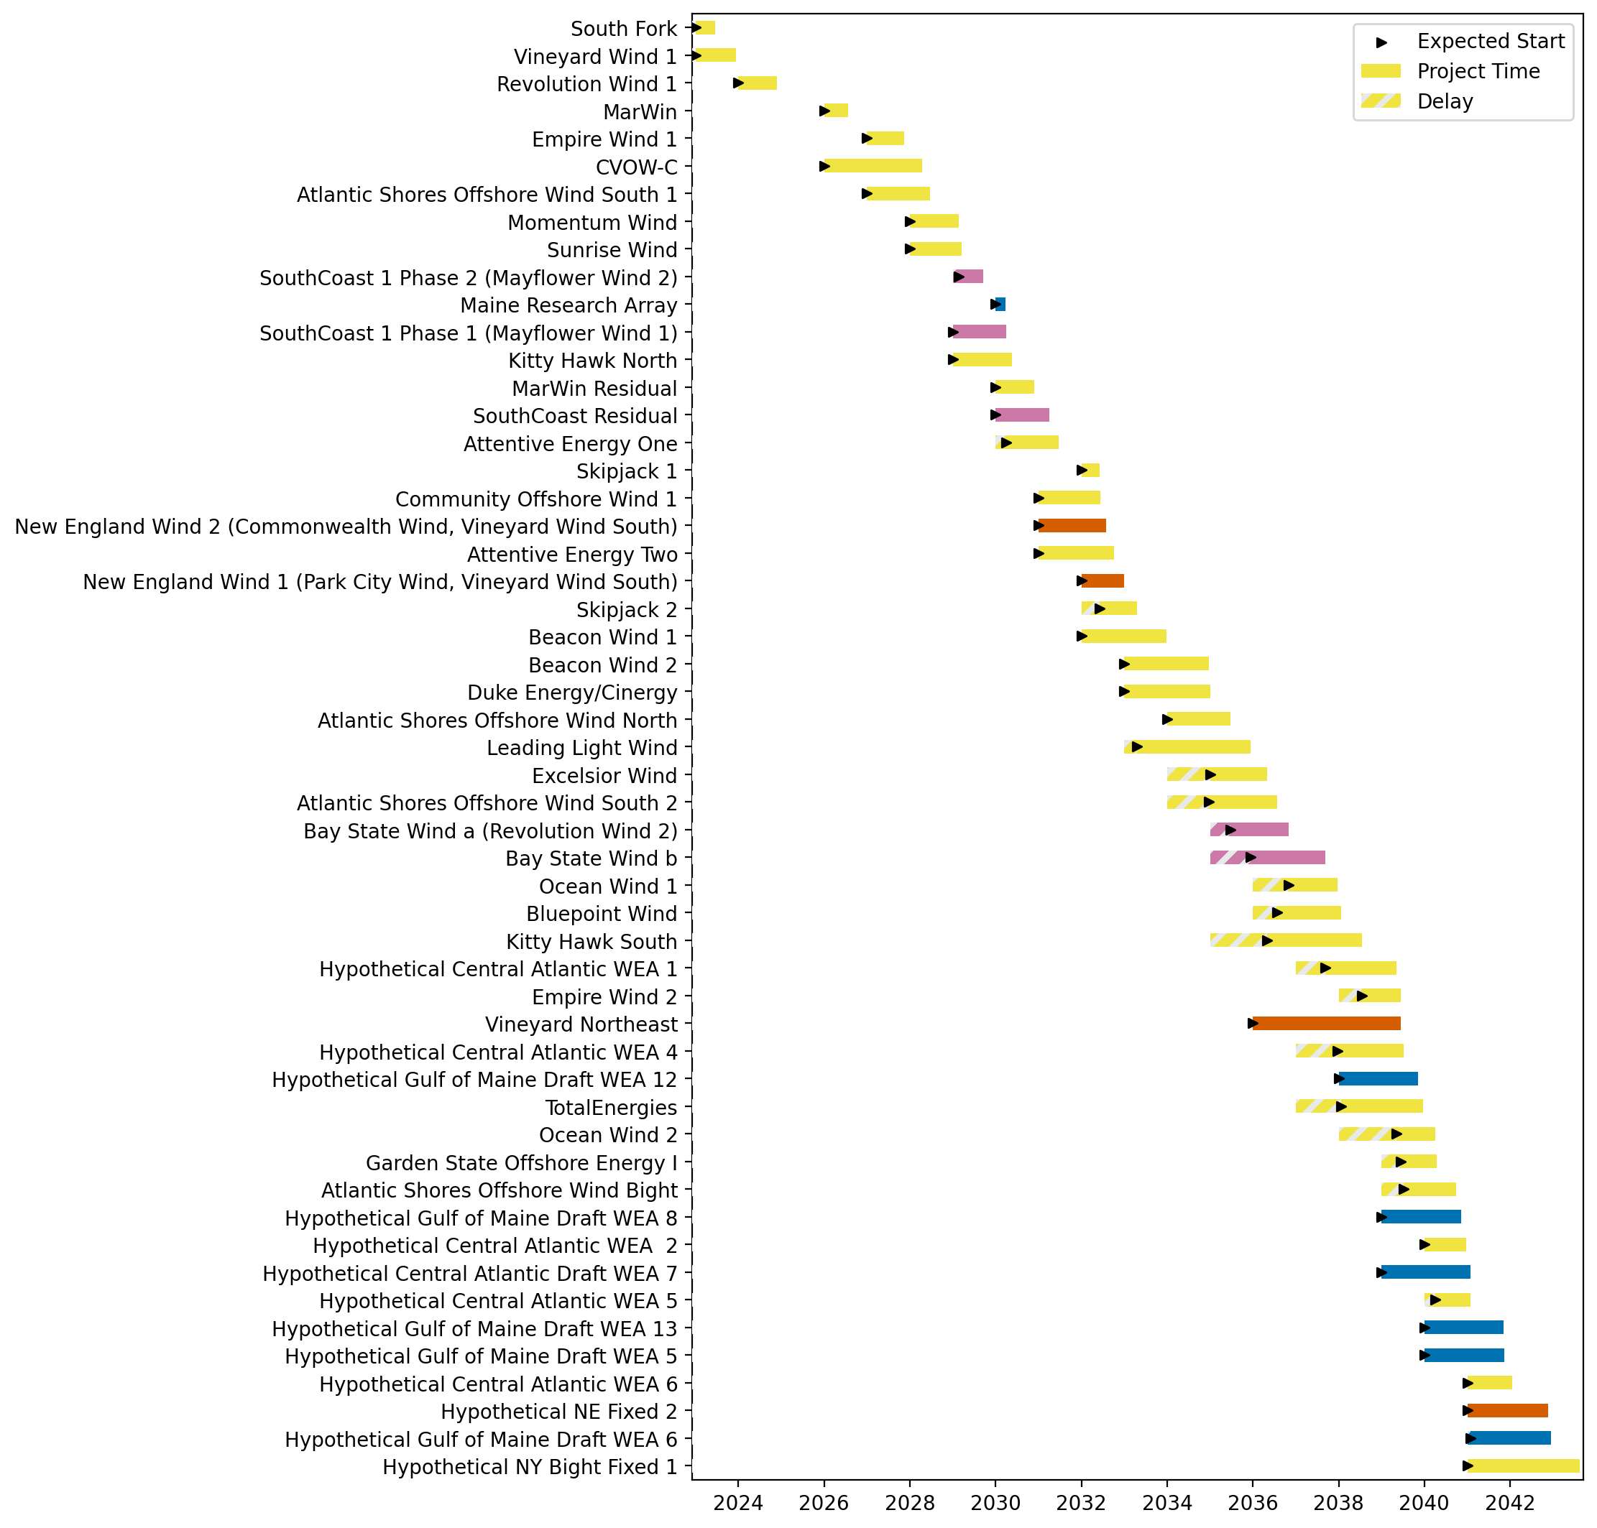
Full Gantt

Slide 3
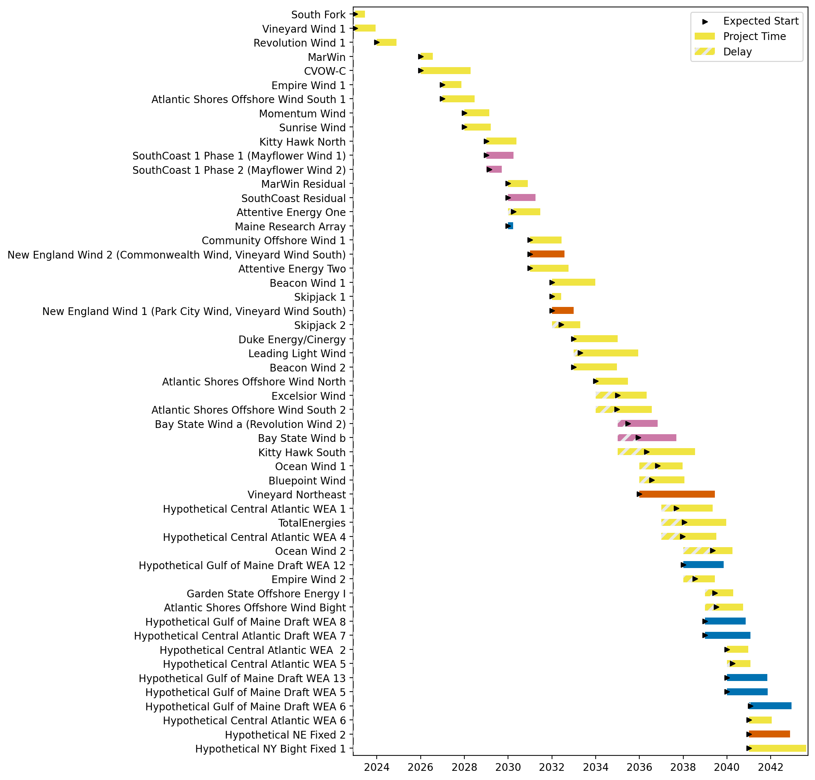
Sorted Full Gantt

Slide 4
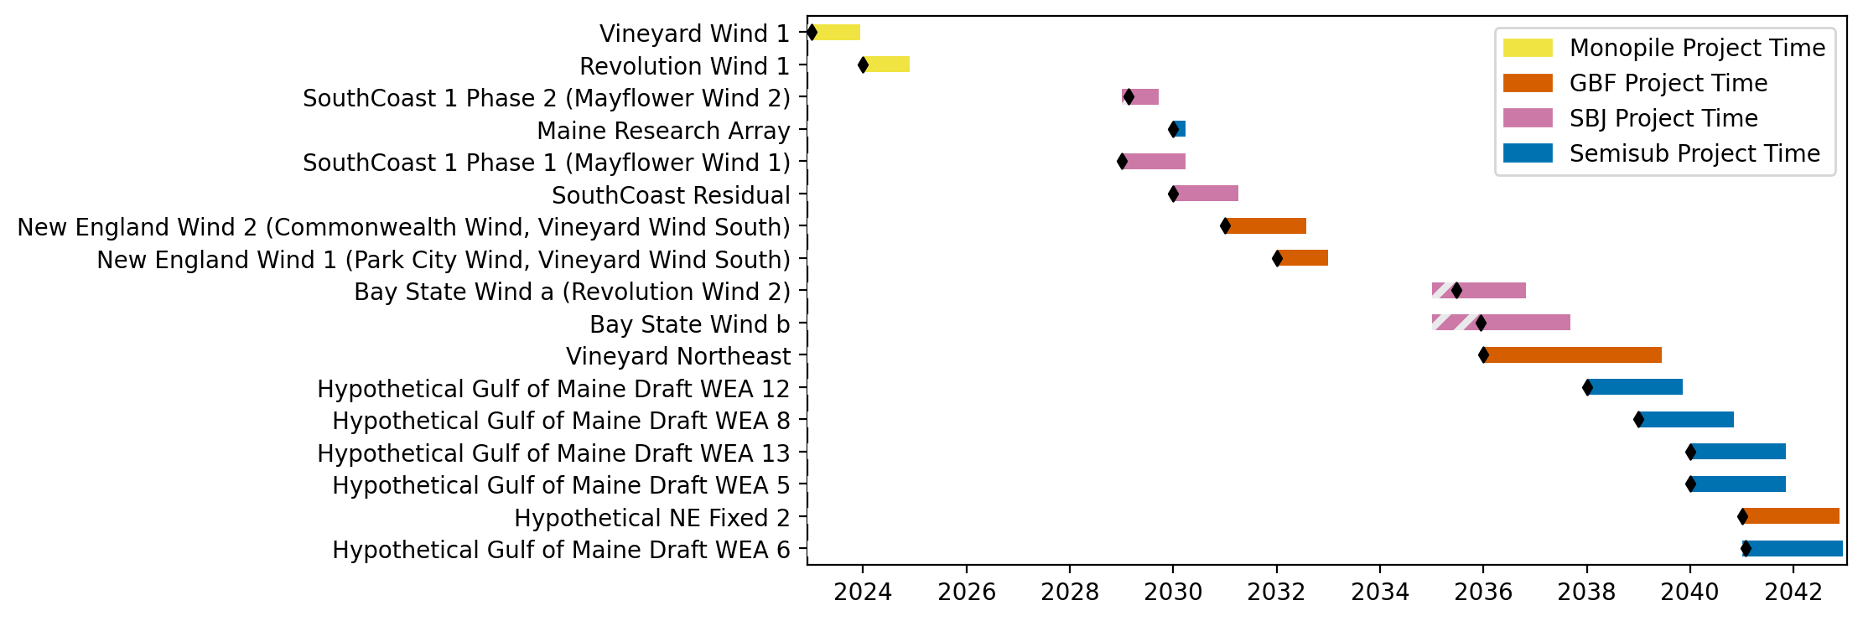
New England Gantt

Slide 5
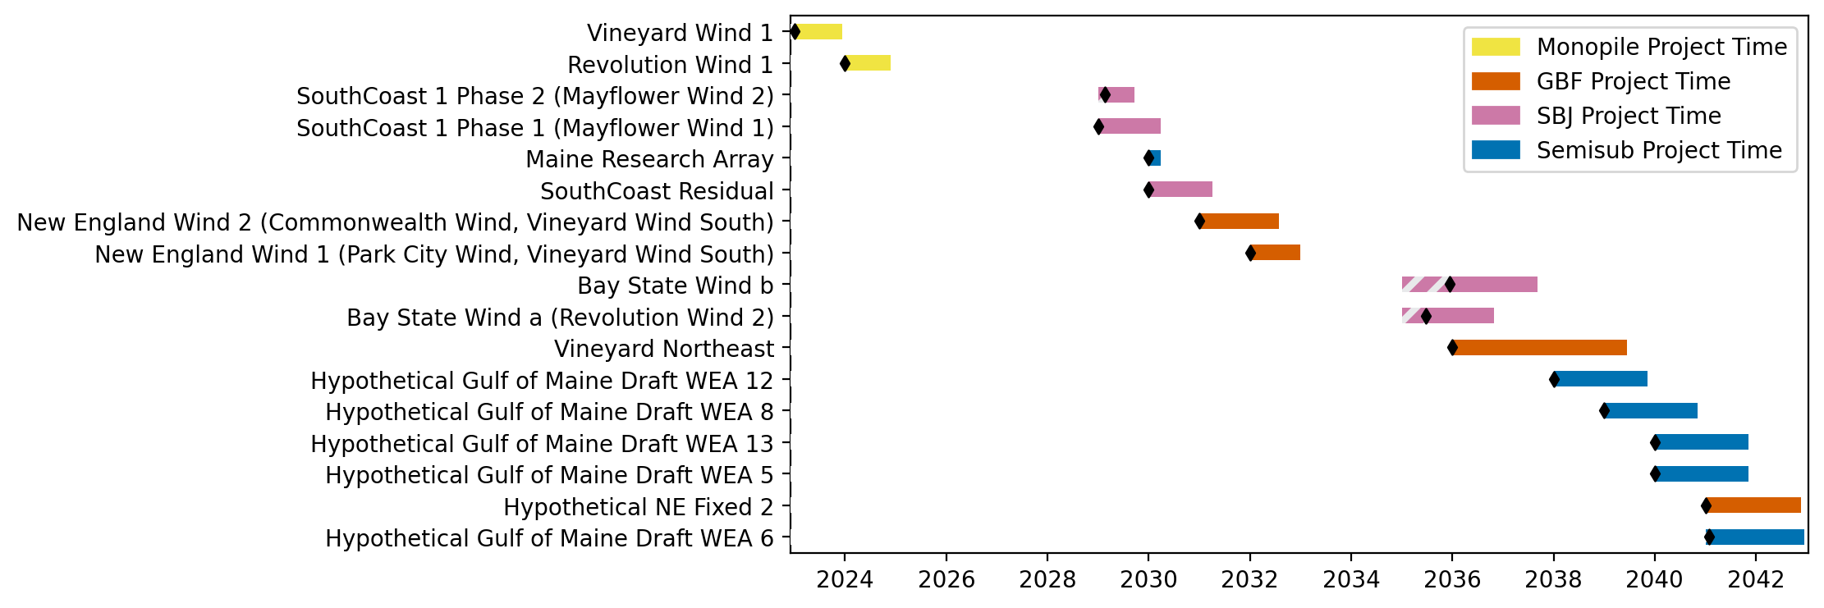
Sorted New England Gantt

Slide 6
best_path_forward
Pipeline: Best Path Foward
Vessel Pathway: Common
Port Pathway: Common

Slide 7
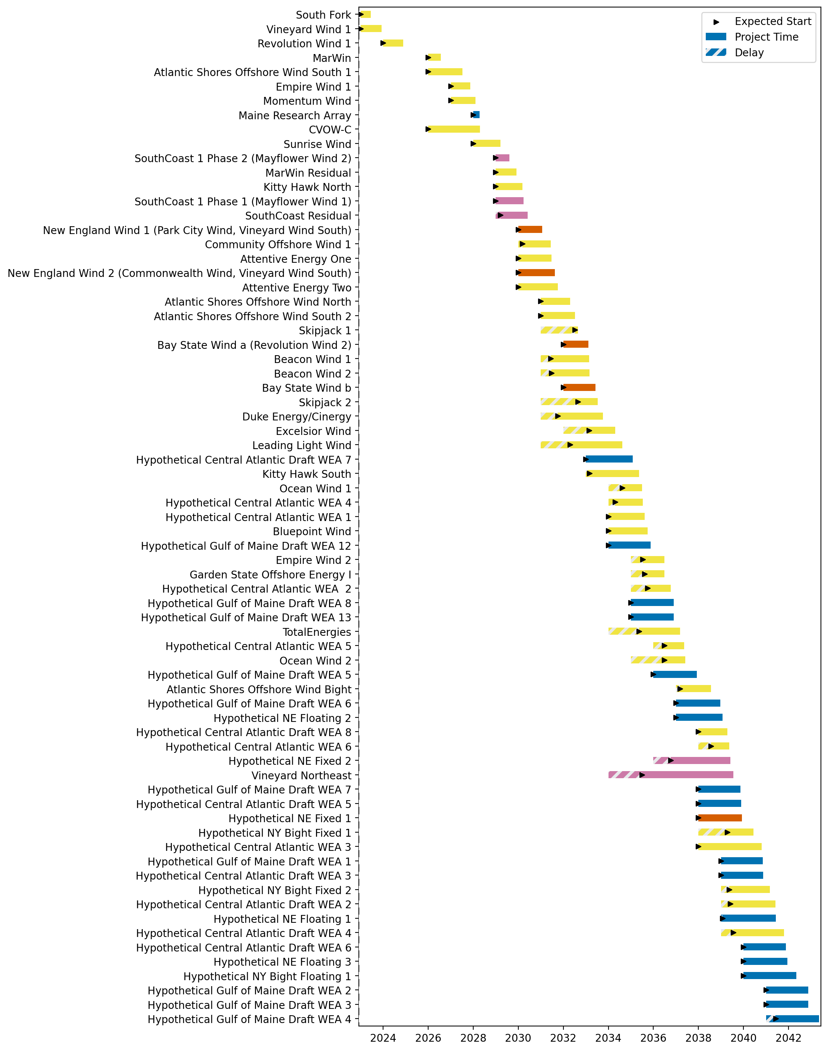
Full Gantt

Slide 8
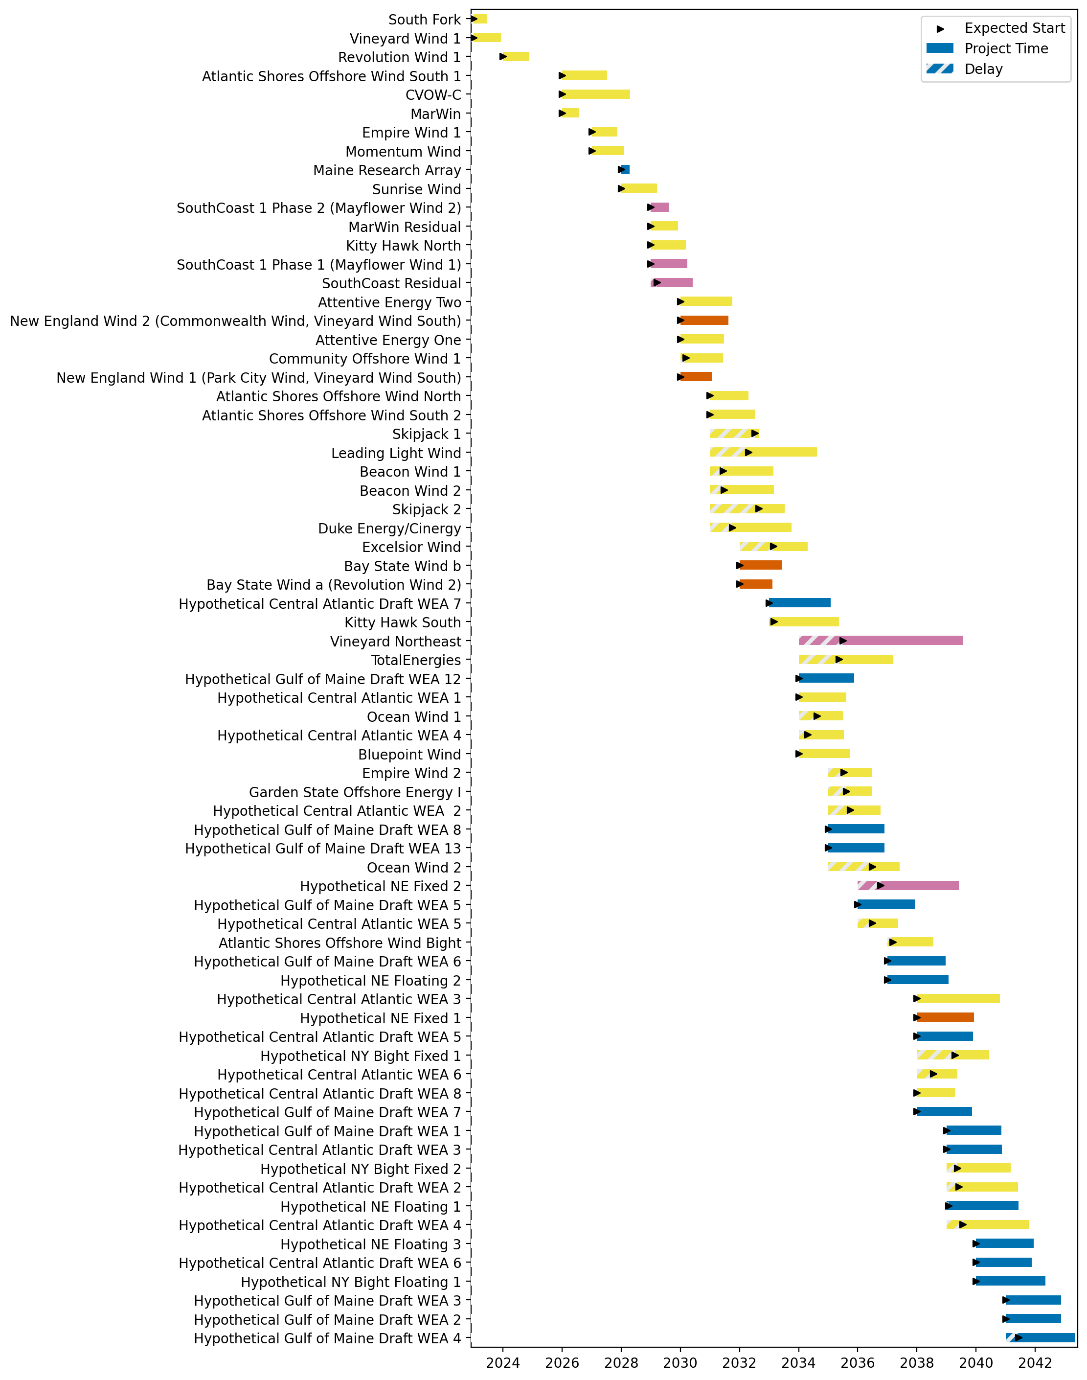
Sorted Full Gantt

Slide 9
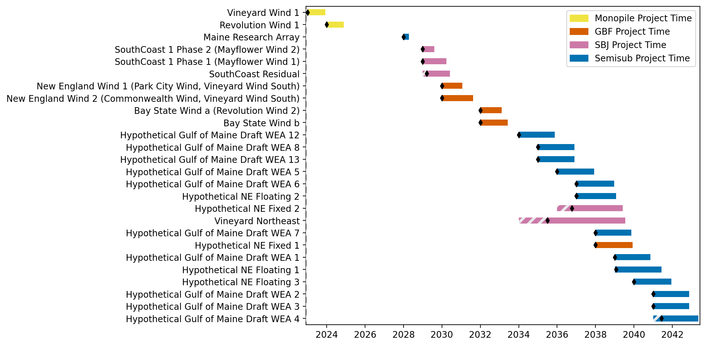
New England Gantt

Slide 10
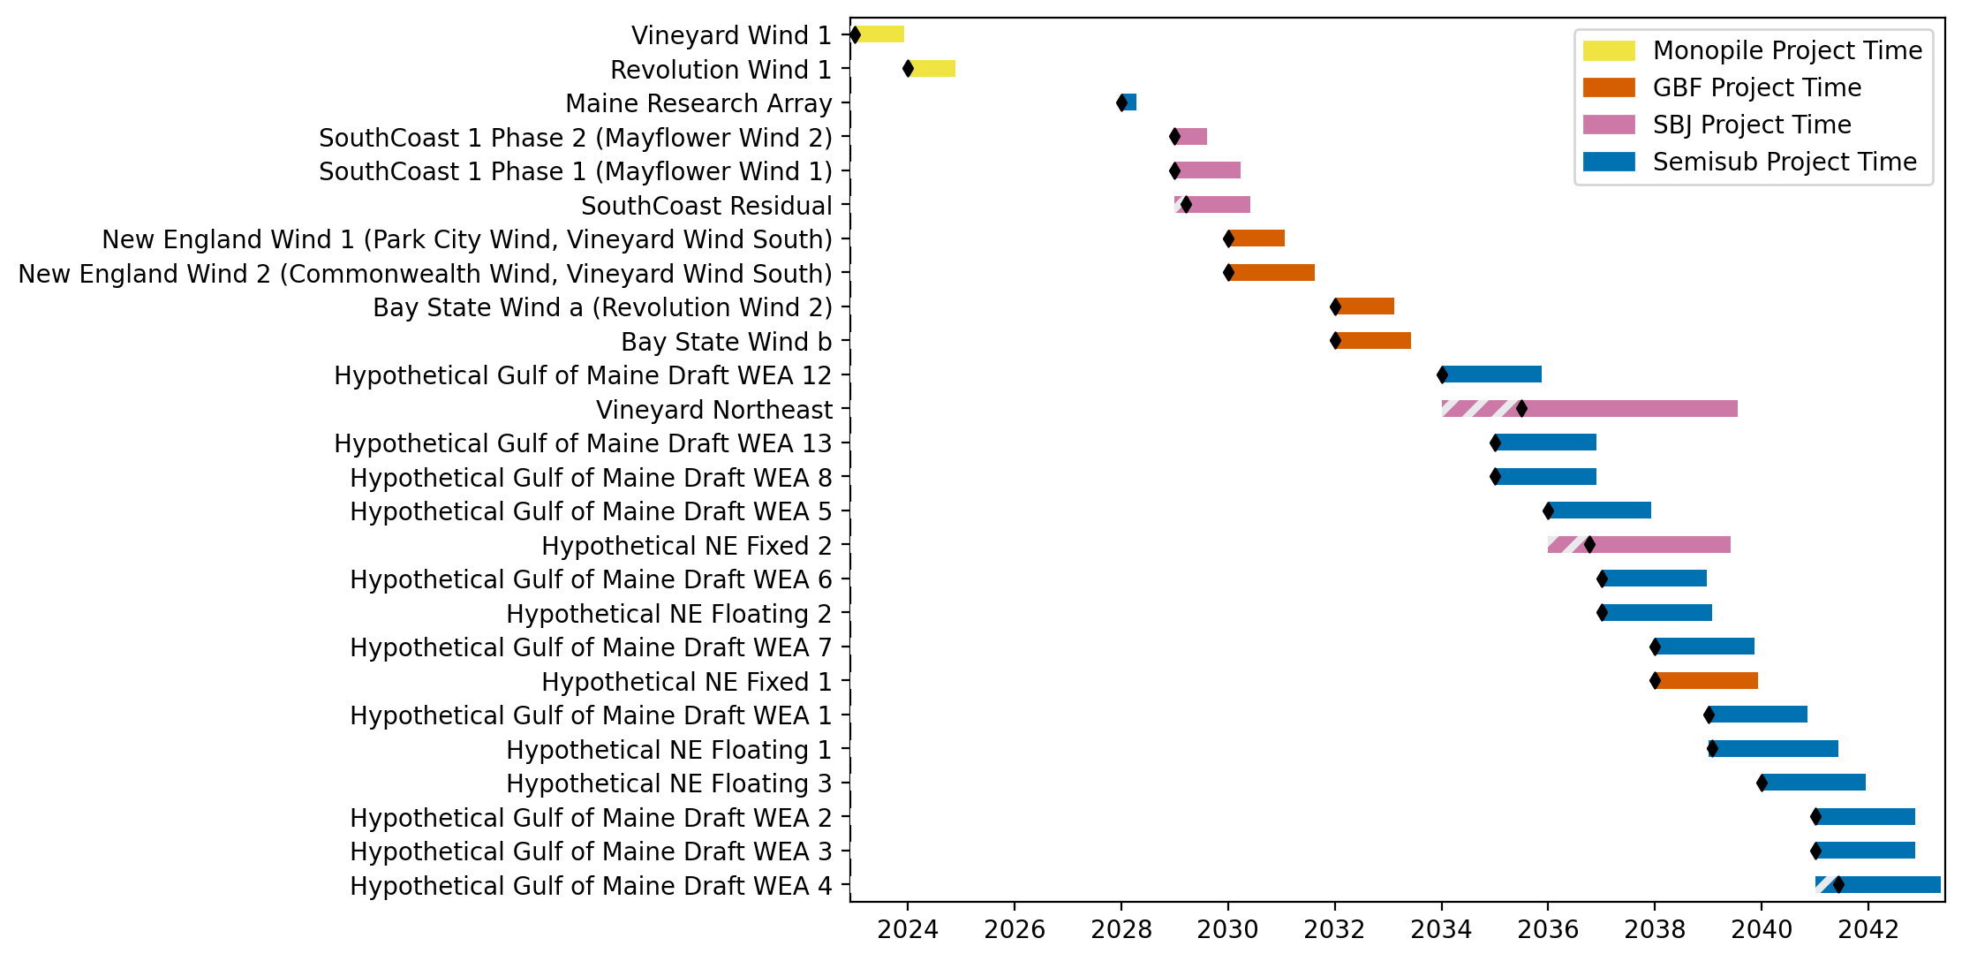
Sorted New England Gantt

Slide 11
high_deployment
Pipeline: High Deployment
Vessel Pathway: Common
Port Pathway: Common

Slide 12
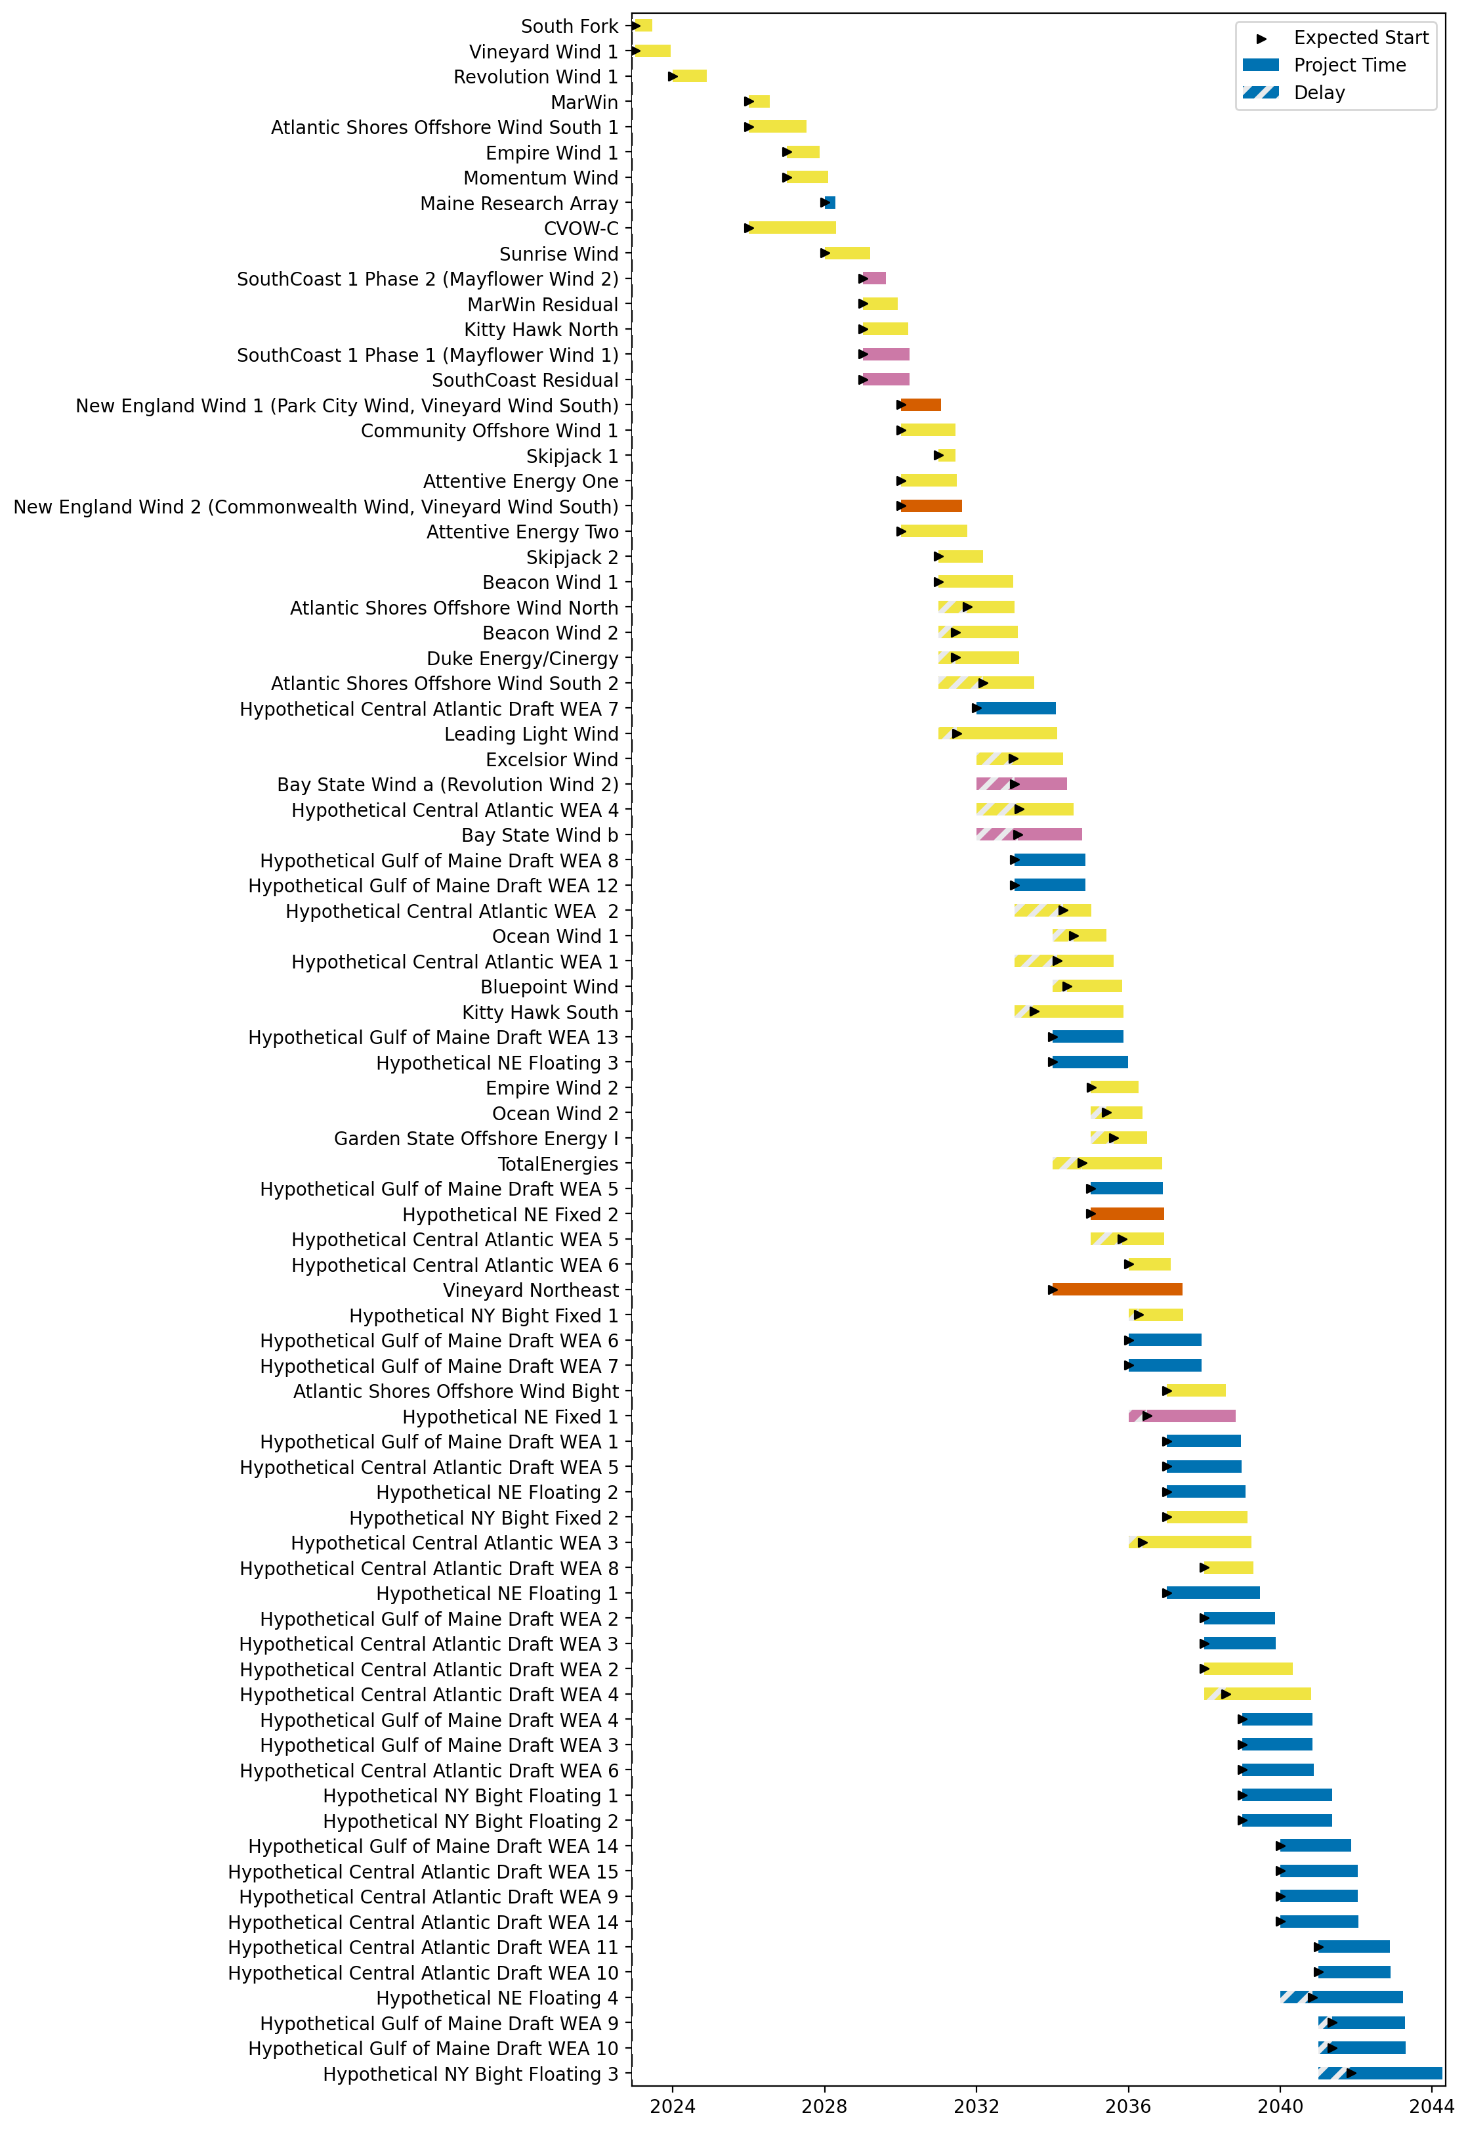
Full Gantt

Slide 13
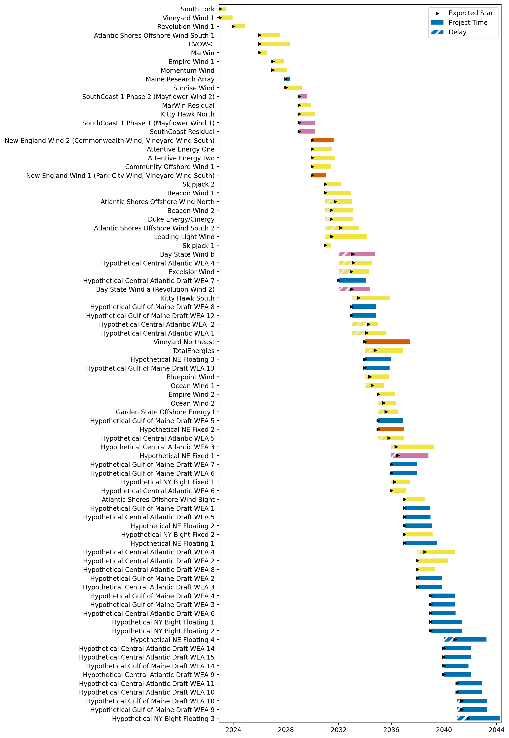
Sorted Full Gantt

Slide 14
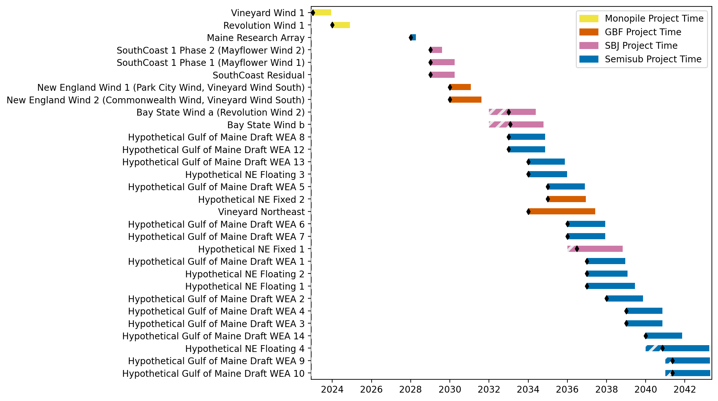
New England Gantt

Slide 15
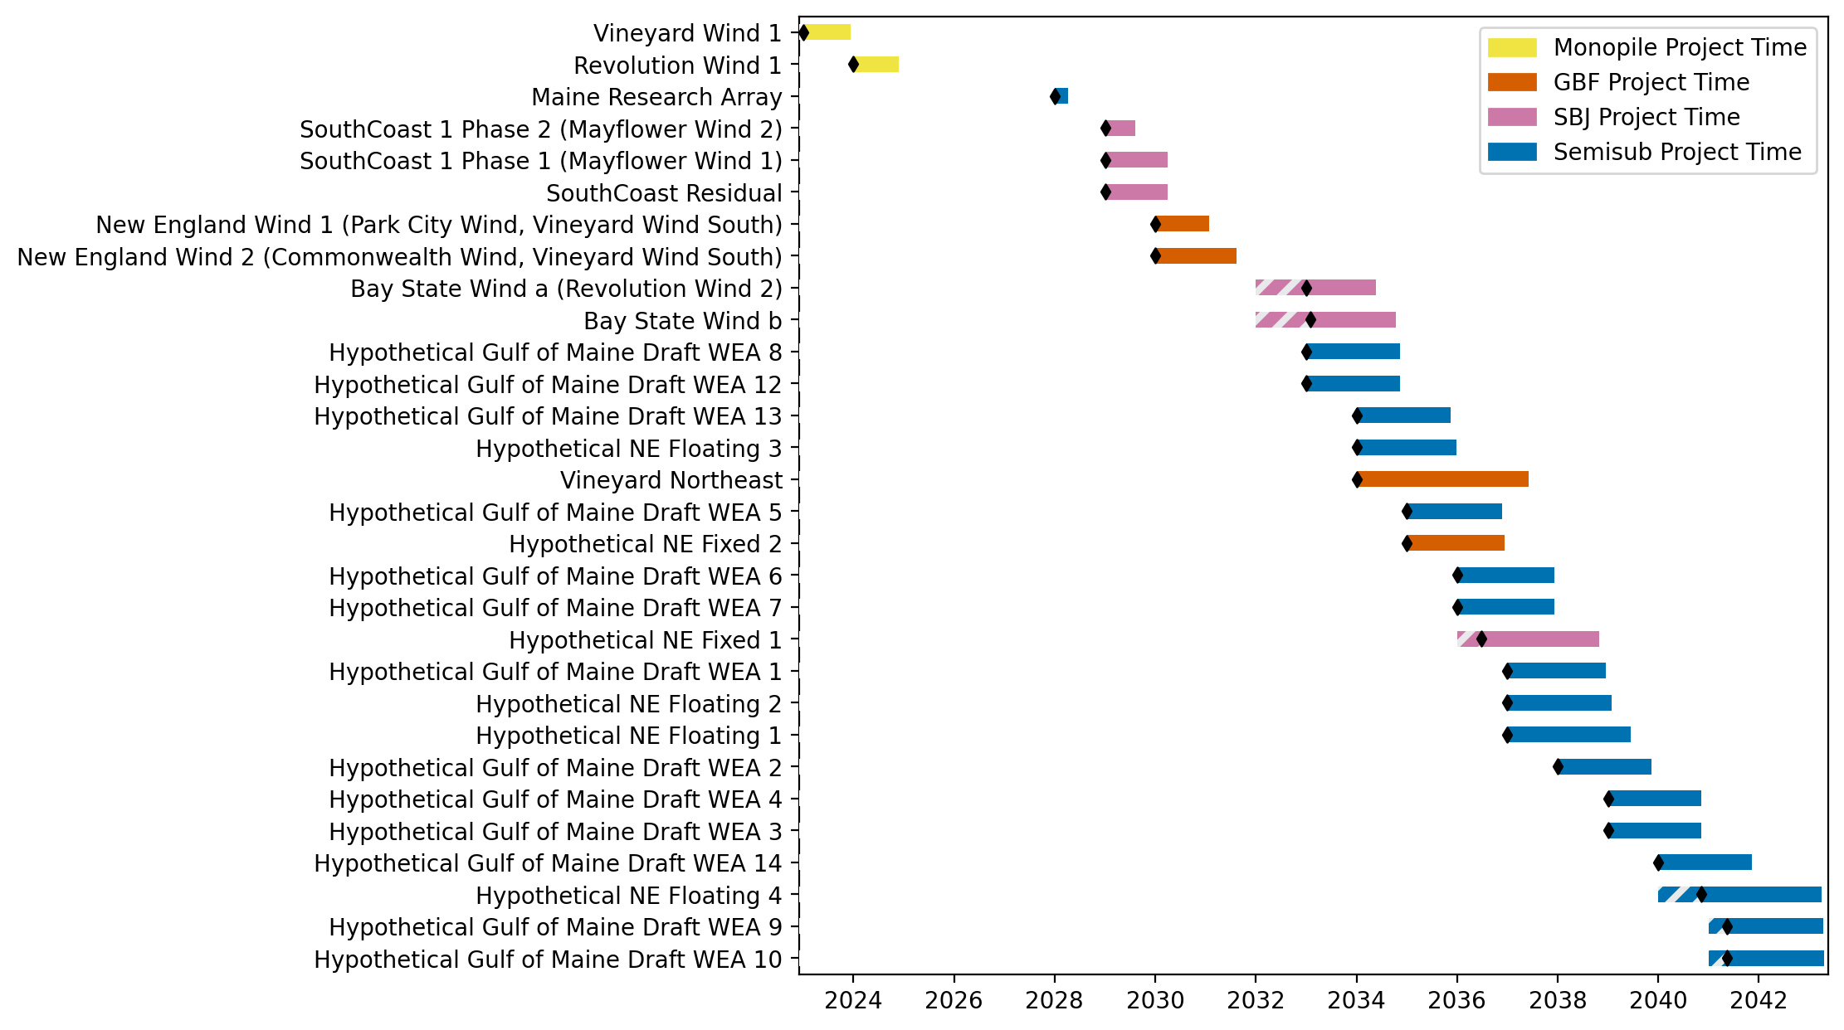
Sorted New England Gantt

Slide 16
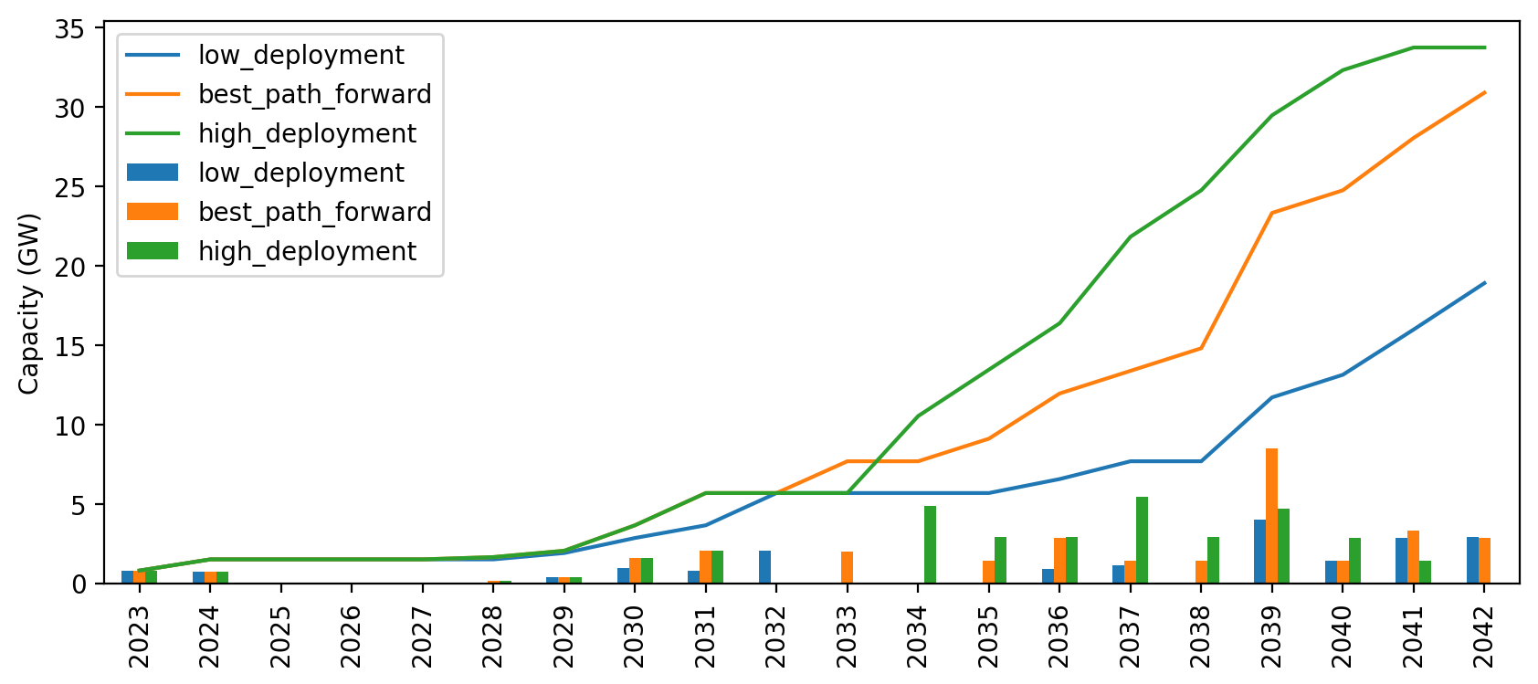
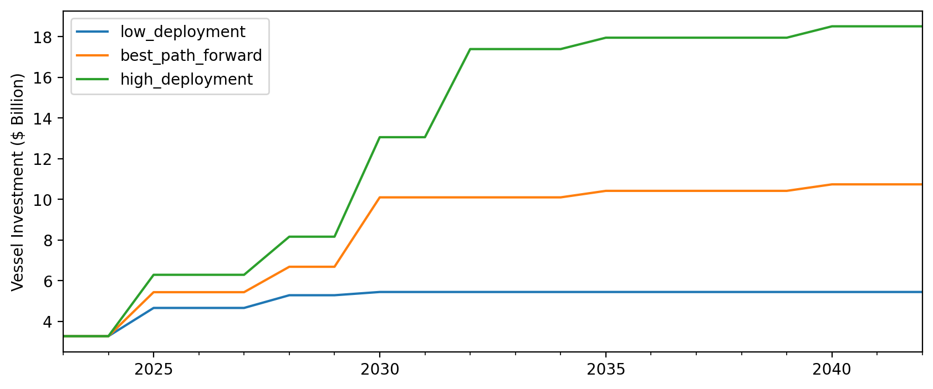
Cumulative Installed Capacity

Slide 17
Vessel Investment Plot

Slide 18
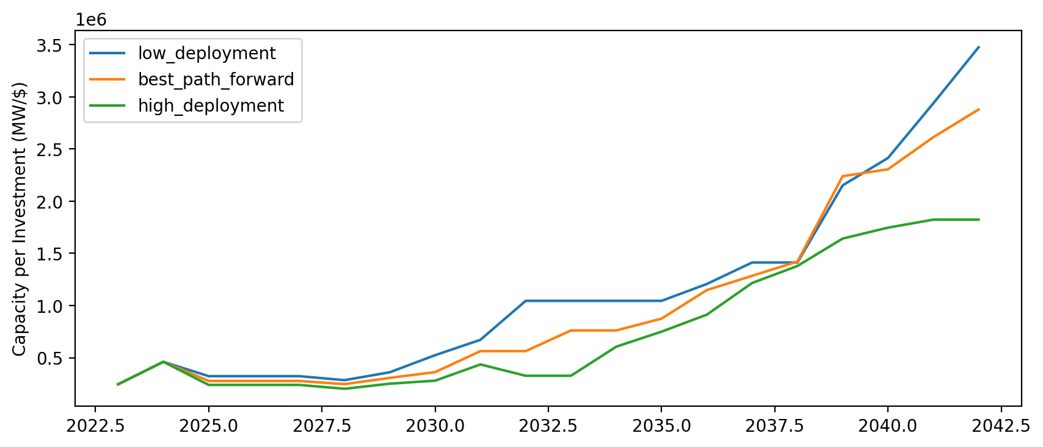
Capacity per $ Invested (MW/$)

